Slide 1



Hyperledger Fabric
Tech Challenge RTP Hands On Workshop
Grant Steinfeld
IBM Developer Advocate – Blockchain and JVM
New York City
Presentation slides
https://bit.ly/2J7DAN2
Blockchain Explored Series
IBM Blockchain Platform Explored
Architectures Explored
Fabric Explored
Twitter: @gsteinfeld
VS Code Extension demo
v2.0.0 October 22nd 2019
Notes:
This is a technical dive into blockchain architectures. Presentations in the “Explored” series are:
IBM Blockchain Platform Explored: How the IBM Blockchain Platform works.
Architectures Explored: Good blockchain architectures
Fabric Explored: Technical dive on Hyperledger Fabric
Code IBP extension
Technical demos:
Coffee BlockBean - Fair Trade
Simple tic-tac-toe - follow along ( time permitting _ Code IBP extension
Wrap
Q&A

Slide 2
Agenda
Introduction
Blockchain Basics
Hyperledger Fabric Blockchain
VS code workshop – Commercial Pater
Q&A

Slide 3
Introduction
Developer Advocate at IBM, specializing in Blockchain, JVM and NodeJS
Senior software architect engineer 25 years
Distributed systems - Trading systems and decision analysis
Blockchain interest 2 years – life logging and personal music playlist ledgers
Blog: https://medium.com/@grantsteinfeld
GitHub: https://github.com/grant-steinfeld LinkedIn: https://linkedin.com/in/grant-steinfeld www: https://GrantSteinfeld.com
Twitter: @gsteinfeld
Notes:
Storytelling, documentation, ecosystems

Slide 4
Blockchain 101
Distributed ledger technology underlying bitcoin and other cryptocurrencies.
Mechanism for updating truth states in distributed network computing producing consensus trust
Serving as a new form of general computational substrate.
Melanie Swan
Notes:
Satoshi Nakamoto – Bitcoin whitepaper outlined the mechanism of the blockchain to allow for digital currency double spending problem.
Ref: Software Engineering Daily -→ Melanie Swan

Slide 5
Birth of Hyperledger Fabric ( aka Fabric )
Develop blockchain applications
For the enterprise
Key characteristics:
Permissioned
Privacy
Highly modular
Pluggable consensus, ledger, CA …
Smart contract – general purpose language
No `mining` or crypto-currency required for consensus
Notes:
Along with others, IBM identified that core aspects of Blockchains could be used for purposes that Crypto
Highlight key points – biz not fuxn in public
Mismatch biz network vs what other bch networks provided
Biz not func in public –partnerships and private relationships
Higher perf.
15 tx/sec bitound 3000 tx/sec – 25k tx/sec
Performance .5 million tx /min on Mainframe Hardware
Fab written in Go – pluggable api – Java JS or your own
Embed Ethereum VM – solidity good too!
No mining - gas biz make money by trading goods
5 Bch projects / framework – Fabric most popular

Slide 6
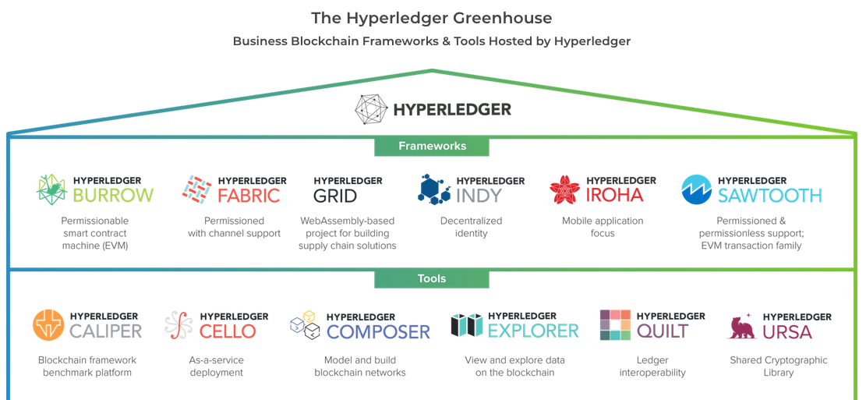
Linux Foundation & Hyperledger Foundation
March 2019
https://www.hyperledger.org/
Notes:
2017
IBM becomes a founding member of Linux Foundation Hyperledger; donates code and intellectual property
2019
IBM HL Fabric v1.4.x LTS
Tool Composer has been deprecated !!
Other interesting Bch platforms :
Sawtooth ‘Proof of elapsed time’ leveraging Intel hardware ( sgx/low energy )
Burrow implementation of Ethererum VM

Slide 7
Fabric Blockchain – Private -Permissioned
Is an enterprise grade distributed ledger
Based on blockchain technology that uses
Smart contracts that enforce trust and business logic
To write to and read from between parties
Notes:
Single sentence that sums it up
Levin?
Иван Ванков
Important - not a single network like Bitcoin or Ethereum
But can be individually deployed for multiple use cases big / small

Slide 8
Fabric – break some assumptions
“Fabric is based on blockchain
But Fabric is not is not a cryptocurrency
You could create a cryptocurrency on Fabric
Fabric does not use mining , but uses a different
Consensus mechanism
Keeps the good parts of blockchain like
Immutability, solves double spending”
Ivan - Иван Ванков
Notes:
Single sentence that sums it up – Read/paraphrase – Ivan on Blockchain
Watch seriers by Ivan
https://www.youtube.com/watch?v=BLT-nCdsS4I

Slide 9
Fabric – 4 key elements
Certificate Authority
Notes:
Fabric CA [optional]
High quality tool - Certificate Authority Service
x509 (Hardware Secure modules)
`certificate issue generate for each user`
can add attributes ...
> roles
> account number
chain code can read this information and make
business decisions
* register users - enrollment *
username, cert life span or other data
from or your own AD/LDAP
Can chain CA Root Chain as long as you want
`Cert lives on the SDK - Client APP -- All operation or request must be signed`
this data is on the blockchain - for tracking

Slide 10
Fabric – 4 key elements
Certificate Authority
Peer
Notes:
1 dev n prod
Endorse and updates the ledger.
Ledger lives here
Discoverable
add peers to increase performance - scale hoz + load balance

Slide 11
Fabric – 4 key elements
Certificate Authority
Peer
Ordering Service
Notes:
Heart consensus - solve double spending problem
Provides order of ops
before
creates the block signed and verified
Pass back to commiting peer to write to the ledger
#### 2 types orderers
Solo Order (dev/test) 1-instance
Apache Kafka (production) - distributed
1000s tx/sec
Server - pi v.s. osZ :)

Slide 12
Fabric – 4 key elements
CHANNELS
Farm - Peer
Shipper -Peer
Buyer -Peer
Notes:
What - Connect the peers
&& Isolate –them Privacy – permissioned
Why? Not all parts of ledger should be shared - therefor permissioned
How? Each channel in H.F. has it’s own Blockchain

Slide 13


Hyperledger Fabric V1 Architecture
External-CA
Fabric-CA
optional
Membership
Services
optional
Admin
Peer
0: Enroll
1: Submit Proposal
2: Execute CC
3: Return Endorsed Response
Endorser
Client
Application
SDK (HFC)
5: Order TXs in a batch
according to consensus
7: Validate & Commit Tx
4: Submit Tx
Committer
O
O
6: Deliver batch
Ledger
Chaincode
A
B
O
O
Events
!
8: Notify
Ordering-Service
Hyperledger Fabric Network
Notes:
Membership – identity - root of trust
Client sdk
Unique not just one node in norm
3 nodes
endorser and commiter
Midlle green orderer
1 App sdk end proposal to endorser
2 exec cc
3 sends endorsement to client read-write set post endorsemnt
4 submits transaction read-write set to ordering svc
5 batch/async consensus – heart of any Bch syst4m – trust
In H.F consensum mechanism is pluggable and tightly linked to the ENDORSE – ORDER –VALIDATION Model
Here validates each tx and commit block, validates endorsement policy blocks are created – cryptography added
6 bach to commiter peers –
7 comits block to bch + world state db
Alll peers validation – ensure that all tx are true – commit to ledger –
8 notify

Slide 14
How applications interact with the ledger
Client
Application
Blockchain
developer
develops
D
SDK
develops
submits
Smart Contract
emits
!
event
accesses
‘get’, ‘put’, ‘delete’
recorded
Ledger
block
txn
txn
txn
emits
!
event
World state
Blockchain
Peer
Notes:
A developer will create an application and smart contract (could be different developers)
The application will invoke calls within the smart contract via an SDK
Those calls are processed by the business logic within the smart contract
- a ‘put’ or ‘delete’ command will go through consensus protocol selected and added to the blockchain
- a ’get’ command can only read from the world state but is not recorded on the blockchain
An application can access Block information via rest APIs such as get block height
Note the use of ‘Delete’ here – delete can delete keys from the world state database, but not transactions from the blockchain, which we’ve established is immutable.

Slide 15
Fabric - Technology Stack
Application – Auction –Supplychain – Finance - etc
SmartContracts
Go JavaScript Java ( Solidity )
CLI
Visual Studio Code + IBM BP Extension
Hyperledger Fabric Basic Network
IBM Blockchain Platform
Containers – Red Hat OpenShift - Kubernetes and Docker
Gossip tcp/ip / LAN / VPN / Internet / Cloud
Notes:
We are about to explore how to demo a blockchain app with visual studio code

Slide 16
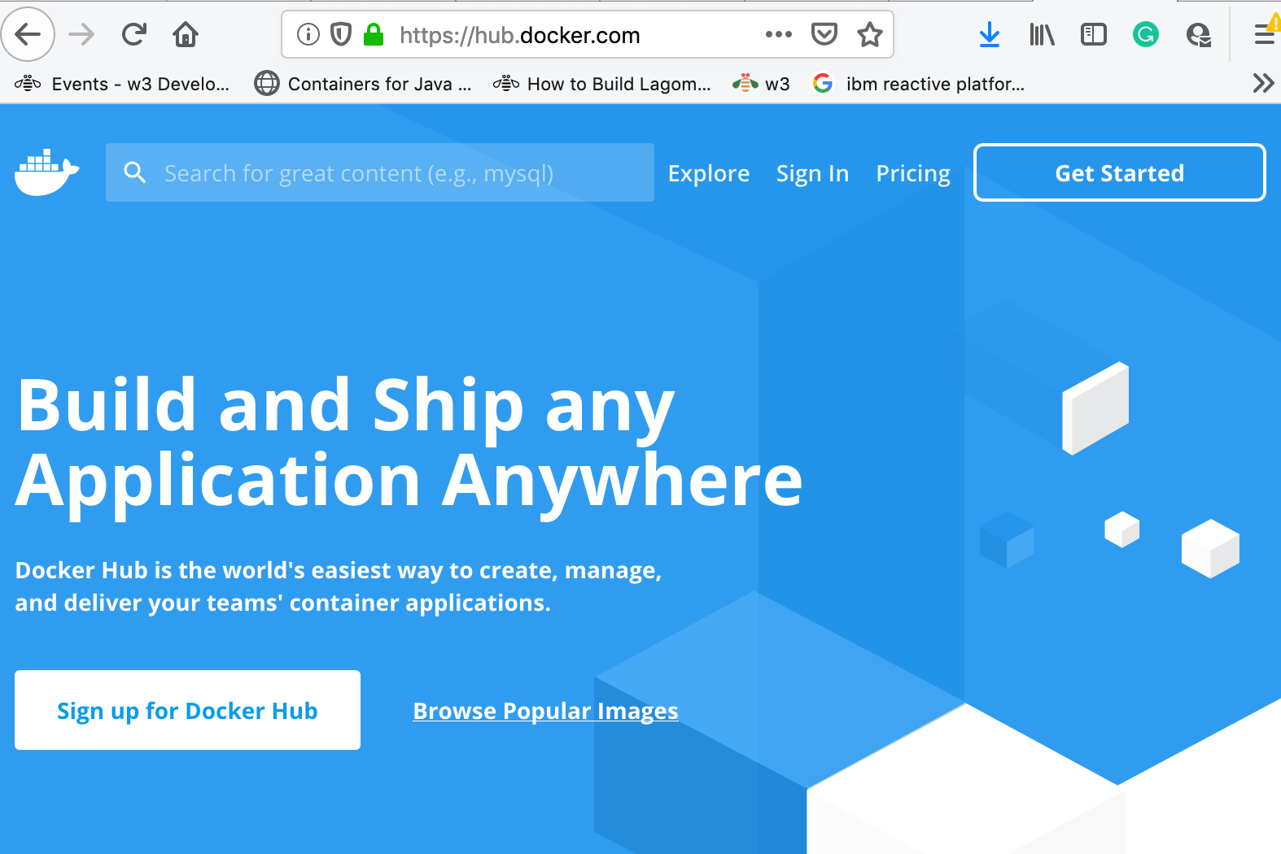
Hands On Workshop – prerequisites
Docker Hub Account – Get Started / Register or Sign In
Create an account or sign in
https://hub.docker.com/
Notes:
https://hub.docker.com/

Slide 17
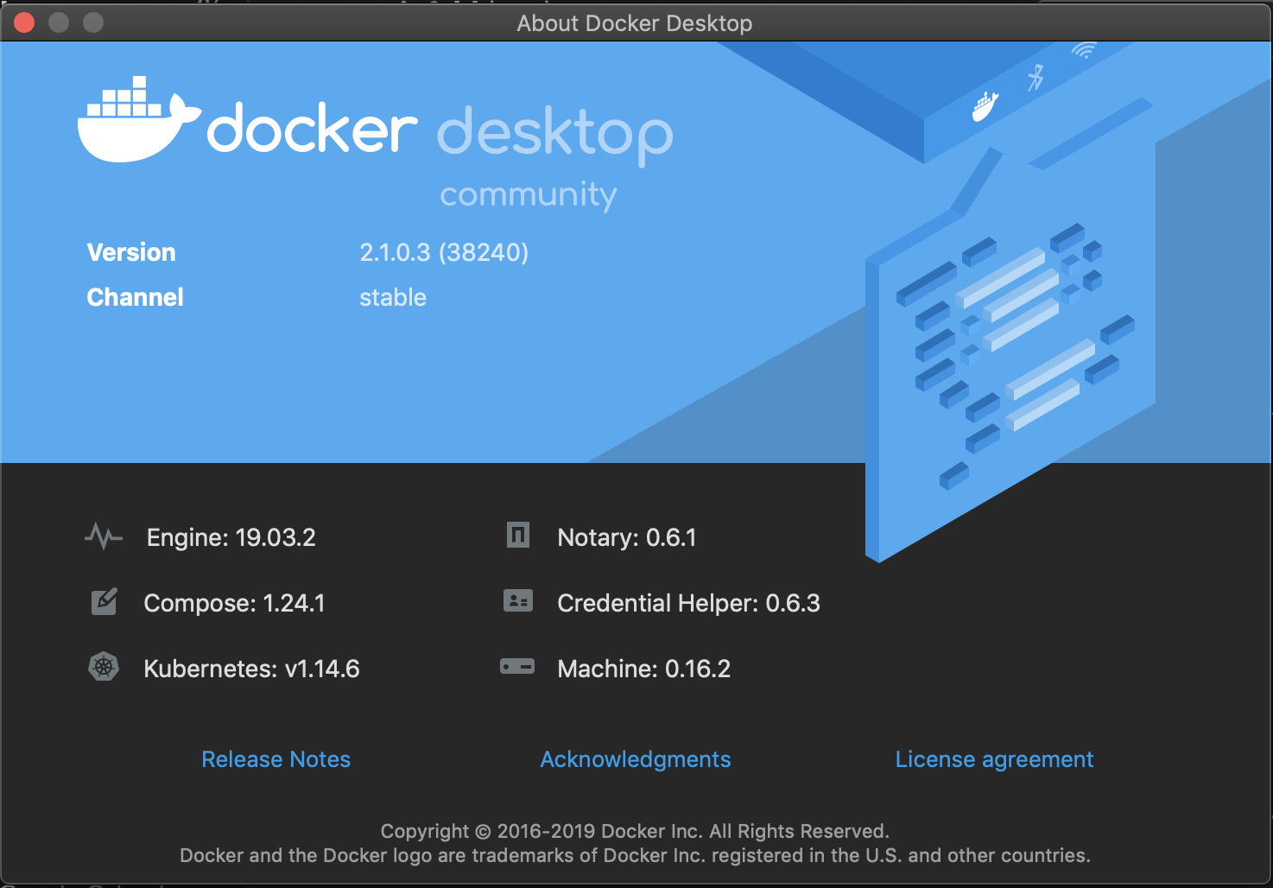
Hands On Workshop – prerequisites
Docker CE

Slide 18
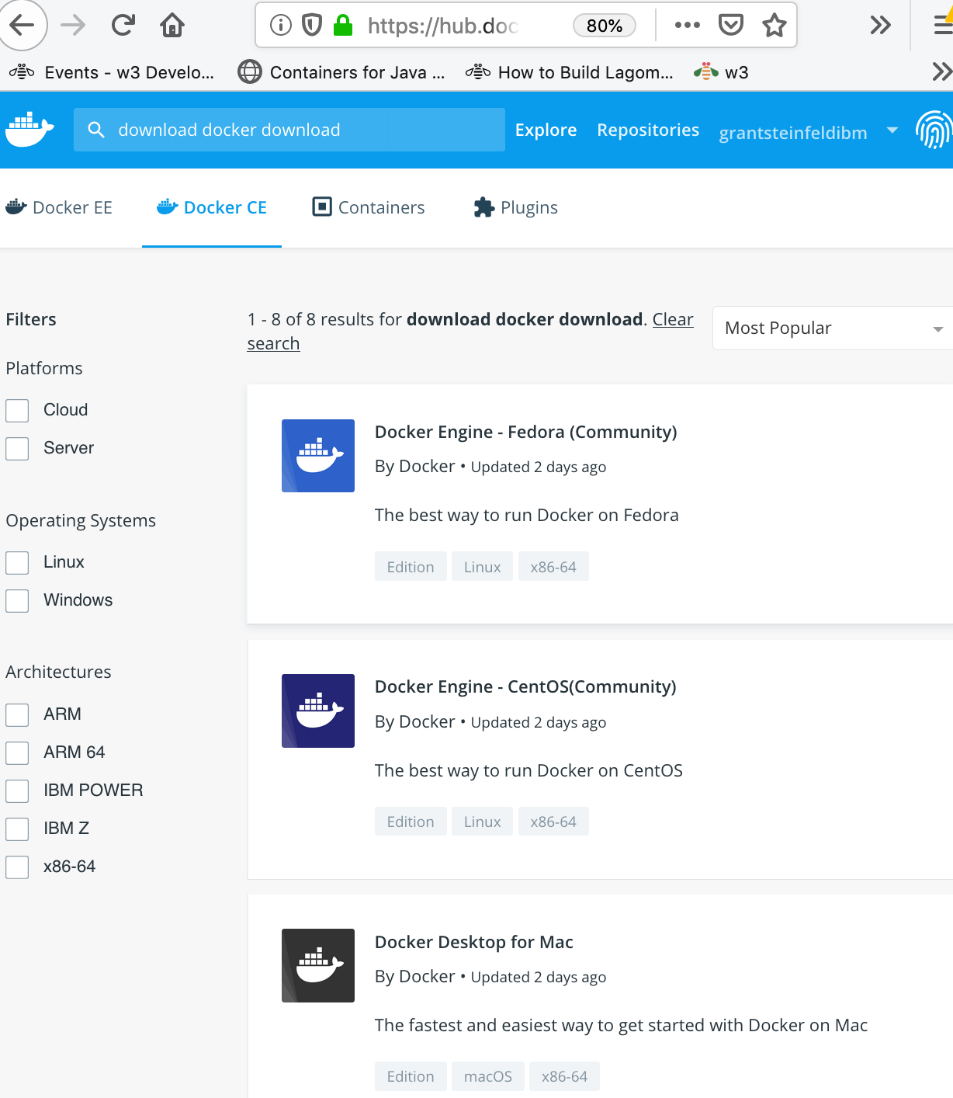
Hands On Workshop –
download
Docker CE
Notes:
Need a docker hub account to download!
Once installed on mac you shoud start docker.app and see it in your toolbar
Login via logging into to Icon on toolbar

Slide 19
Hands On Workshop –
download
docker-compose
you can use the usual commands to install or upgrade Compose:
curl -L https://github.com/docker/compose/releases/download/1.25.0-rc2/docker-compose-`uname -s`-`uname -m` -o /usr/local/bin/docker-compose chmod +x /usr/local/bin/docker-compose

Slide 20
Hands On Workshop – prerequisites
Docker CE

Slide 21
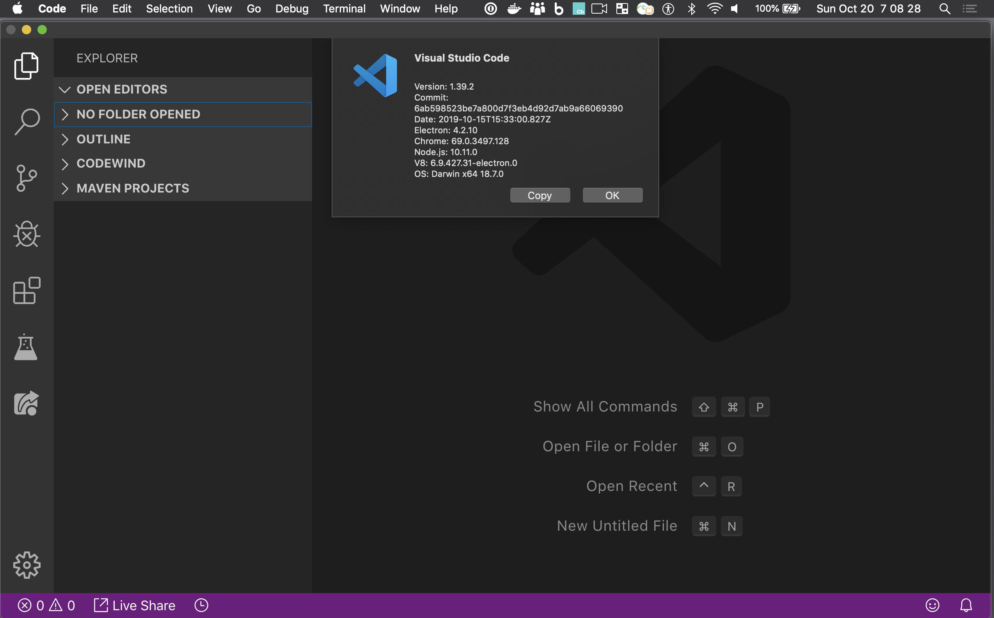
Hands On Workshop –
download
Visual Studio Code

Slide 22
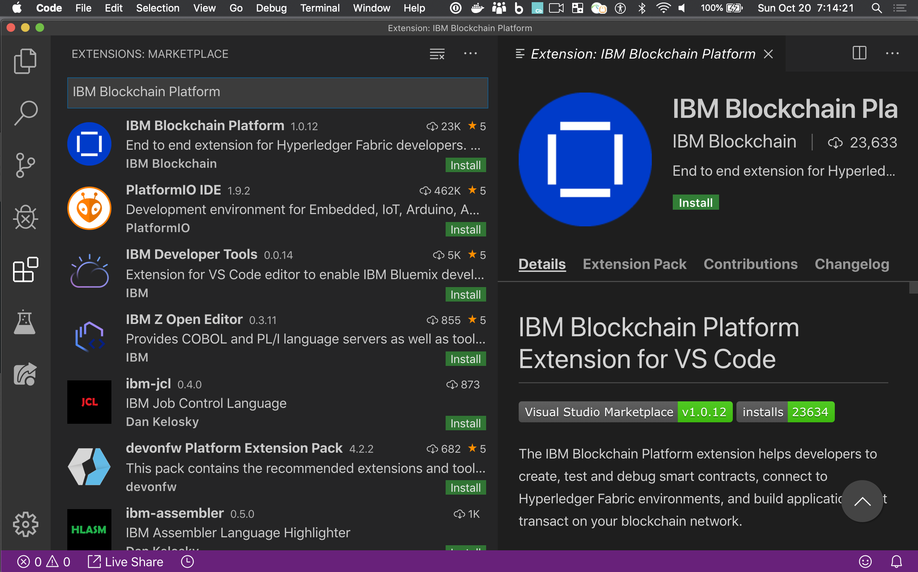
Hands On Workshop –
Install
IBM Blockchain Platform
Extension for Visual Studio Code
Notes:
May take a while depending on Bandwidth
The IBM Blockchain Platform extension helps developers to create, test and debug smart contracts, connect to Hyperledger Fabric environments, and build applications that transact on your blockchain network.

Slide 23
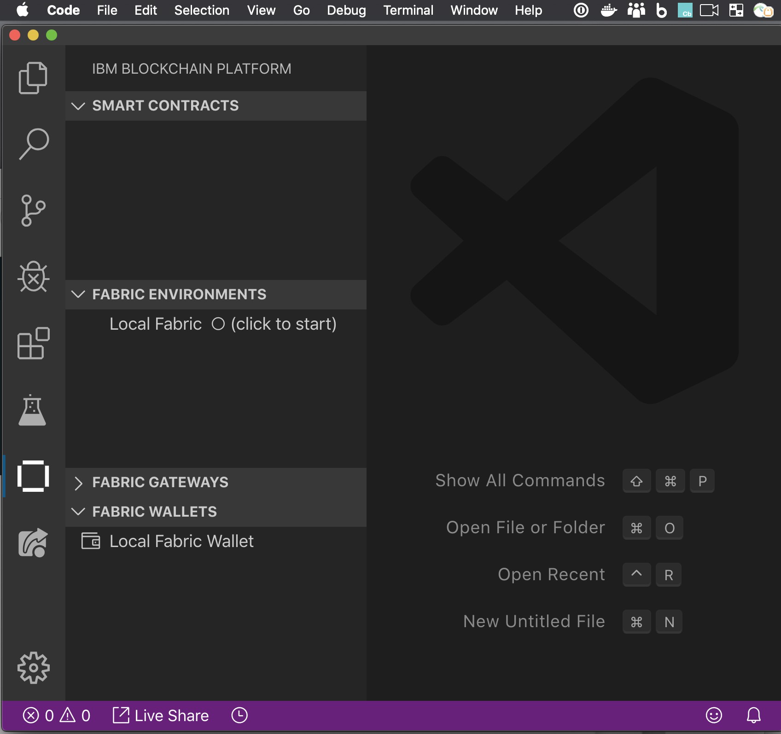
Hands On Workshop –
Success install
Of IBM Blockchain
Platform Extension
for VSCode

Slide 24
Workshop – background Commercial Paper ~= Futures/Options
In short, it’s a way for large institutions to obtain funds to meet short-term debt
obligations. For example, let’s say MagnetoCorp issues a commercial paper (or “CP”)
on April 1 with a face value of $1 million. It promises to pay the bearer (the “paper”
is transferable, so it can be re-sold) this amount in 6 months’ time (October 1,
the maturity date).
However, on May 1 the CP is purchased by an investment bank (DigiBank) for a
discounted price — $0.96 million (valued at $1 million in 6 months’ time).
If DigiBank holds this until maturity (managing its investment risk in the meantime),
then as the bearer, it can redeem it at face value ($1 million) with MagnetoCorp —
a profit of $40,000.
This is effectively the interest earned on an investment of $0.96m for
6 months
Notes:
. Most investors in the commercial paper marketplace tend to hold it until
maturity, but there are varying marketplaces, options, and strategies … ar beyond the scope of this little explainer.

Slide 25
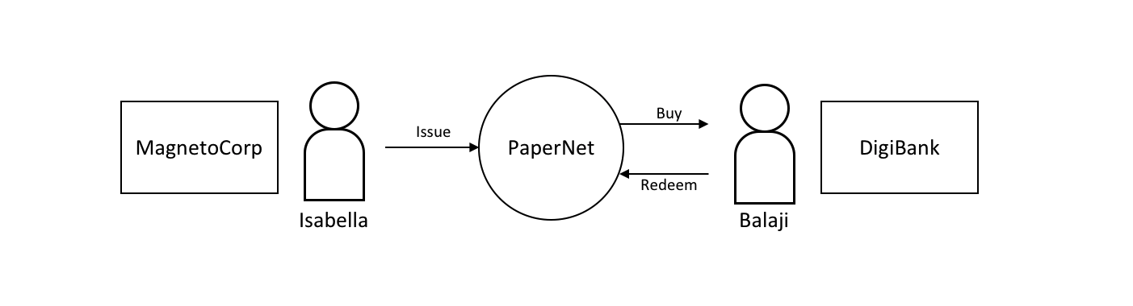

Slide 26
Codetime!!
Commercial Paper tutorial
https://ibm.co/31wdrM3
Notes:
https://developer.ibm.com/tutorials/run-commercial-paper-smart-contract-with-ibm-blockchain-vscode-extension/
Estimated time
After the prerequisites are installed, this should take approximately 45 minutes to complete.

Slide 27
Codetime!!
Add a REST api Client
https://bit.ly/2By6iQt
Notes:
Loopback4

Slide 28
Codetime!!
Add a Web Interface( time permitting)
https://ibm.co/31sJRHe
Notes:
https://developer.ibm.com/tutorials/queries-commercial-paper-smart-contract-ibm-blockchain-vscode-extension/

Slide 29
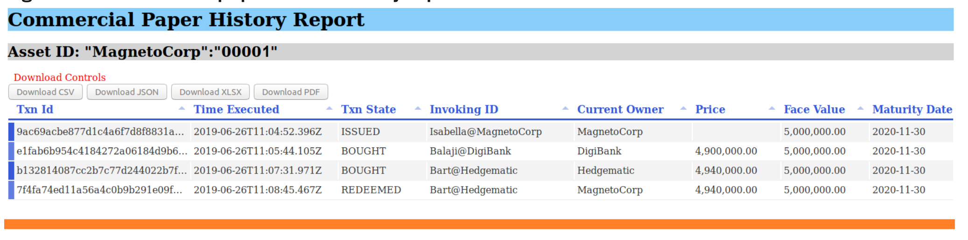
Web Interface
Notes:
https://developer.ibm.com/tutorials/queries-commercial-paper-smart-contract-ibm-blockchain-vscode-extension/

Slide 30
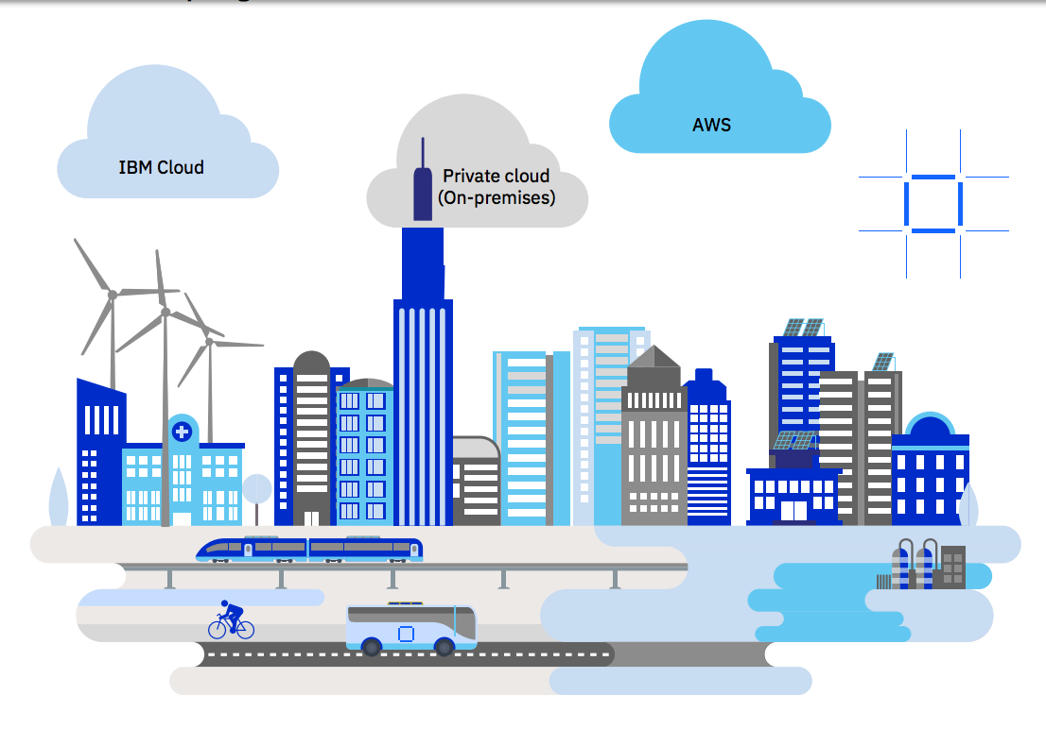
Deploy your Hyperledger Fabric project on IBM Blockchain – ANYWHERE!
Google
MS Azure
Oracle
SAP
Alibaba
IBM Cloud Private
Notes:
What next
You have Developed your first Hyperledger Fabric application How to get it into the cloud
Many options now
Just announce IBP anywhere!
A full-stack cloud platform that spans public, private and hybrid environments.
IBM cloud – reliabily – scalability – speed – IBM Garage / Consulting …
Build with a robust suite of advanced data and AI tools, and draw on deep industry expertise to help you on your journey to the cloud.
--------------------------
Hybrid Cloud on IBM Z

Slide 31
What we have learned
Fabric - Basics of Blockchain for Business/Enterprise
Single distributed LEDGER/DB
shared privately amongst TRUSTED communities
Fabric – IBM contribution to LINUX FOUNDATION – Hyperledger Projects
Technical Hyperledger commercial paper hands on coding/demo using VISUAL STUDIO Code
with IBM Blockchain Platform Extension
Notes:
Distributed LedgeDevelop on a local laptop a prototype
Specifically Hyperledger Fabric and how it forms the foundation of IBM Blockchain Platforms
The adoption of blockchain will be a balancing act for an enterprise.
It will not only have to run, manage, and maintain its existing infrastructure but also
pave the way to this new computational model that promises to fundamentally change enterprises and even whole industries.

Slide 32
Q&A

Slide 33
Tutorial L inks
Commercial paper tutorial
IBM Devloper Tutorial part 1
https://developer.ibm.com/tutorials/run-commercial-paper-smart-contract-with-ibm-blockchain-vscode-extension/
Loopback API part 2
https://github.com/Grant-Steinfeld/HyperLedger-Fabric-Hands-On-Workshop/blob/master/README.md

Slide 34

Thank you!
This presentation, and other tips/issues-feedback please feel free to collaborate on this presentation on GitHub repo https://bit.ly/2J7DAN2

